Slide 1

IBMi in the IT infrastructure of tomorrow
This is a two day workshop squeezed into 60 minutes !!
For:
iTour - Common Denmark
By:
Niels Liisberg

Slide 2
IBMi in the IT infrastructure of tomorrow
Introduction to noSQL
MongoDB on IBMi
Db2 and JSON support
Live stuff !!
You will learn:
  how to say: “JSON”
  How to make webservice request in Query/400

Slide 3

Who is Niels Liisberg?
IBM Power evangelist
“The doctor” – transformation consultant
System & Method A/S – Denmark
Inventor of IceBreak^{tm} – Application server for RPG
Architect of Sitemule^{tm} – Web platform for IBMi
CEAC – Common Europe Advisory Council member
Devoted “open source fanatic”:
  https://github.com/NielsLiisberg
Founder of IBM Power CPH
Follow me at tweeter, github, linkedin , gluf, clap or what ever…

Slide 4
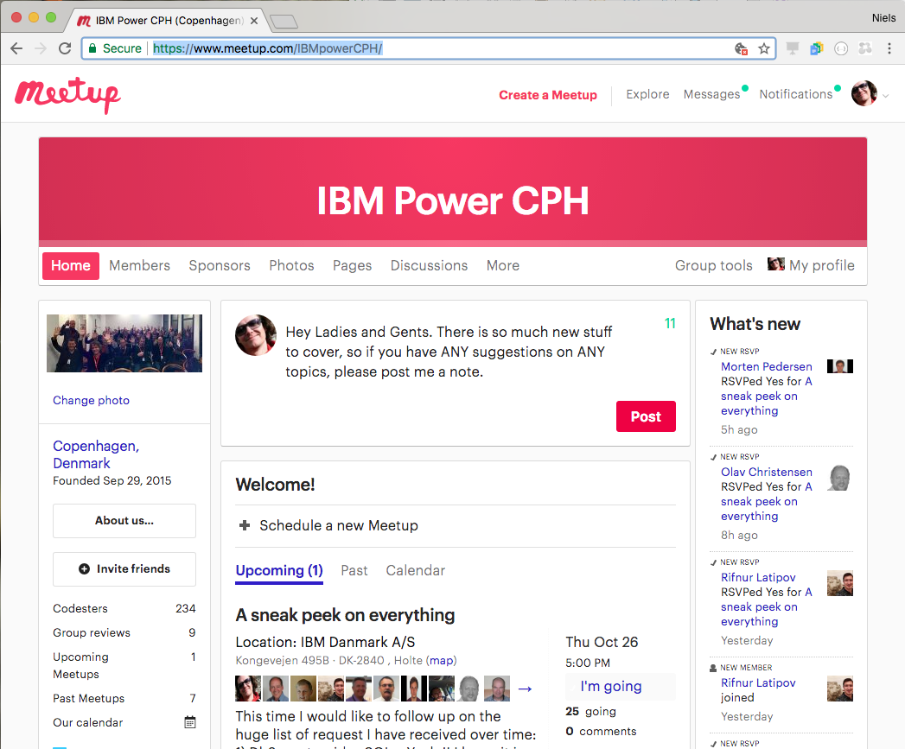

Slide 5
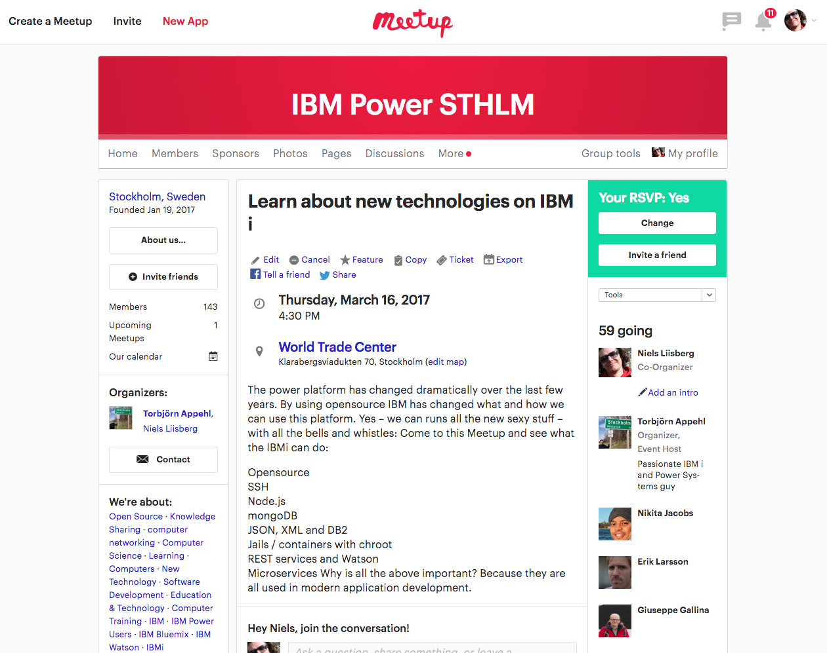
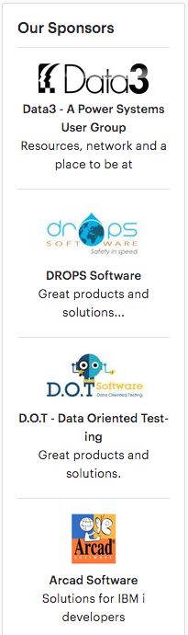

Slide 6
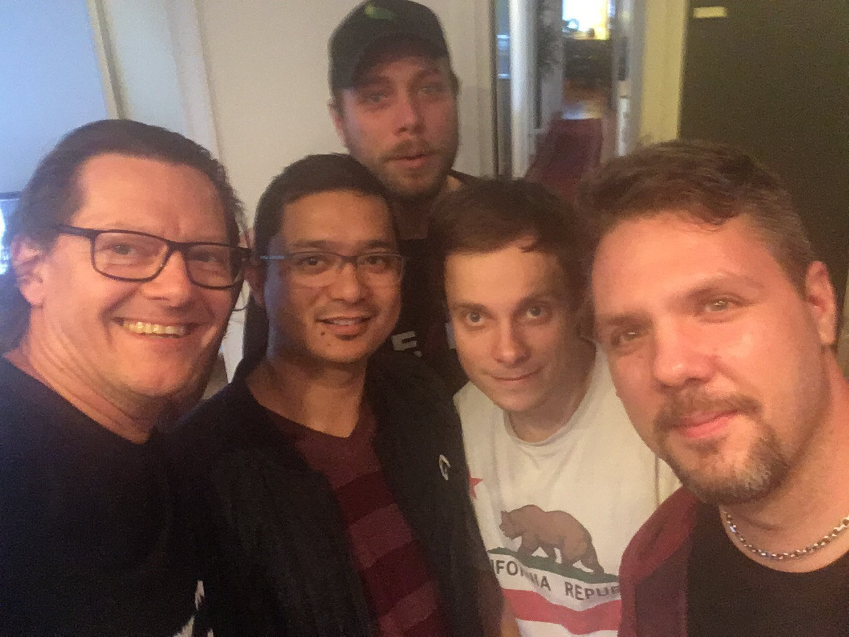
My frontend team
Linux, windows background
Python
Node.js
.NET / C#
HTML / CSS
Angular
ExtJS
Age 23 – 30

Slide 7
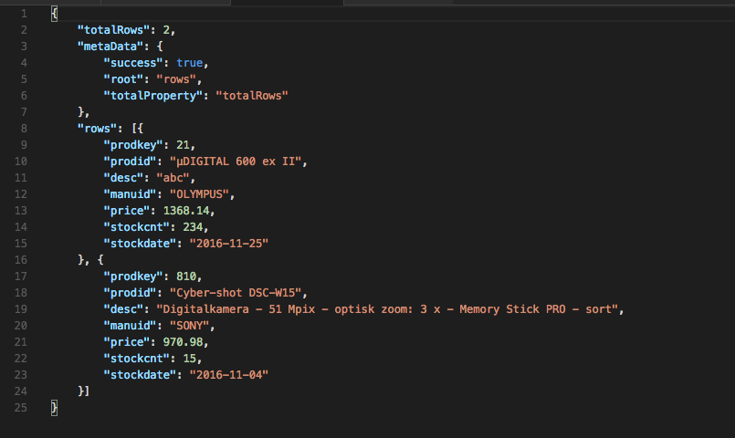
What is JSON?
Cross age/culture developer Esperanto
A humongous number of JSON transactions
Lightweight transporter protocol
Any abstract data types
Any complex data
Human readable
Easy to parse in any environment (IoT)
Easy to produce
Only by simple components:
  Primitives, arrays and object

Slide 8

noSQL
Not
Only

Slide 9
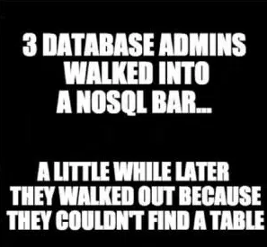
What is noSQL?

Slide 10
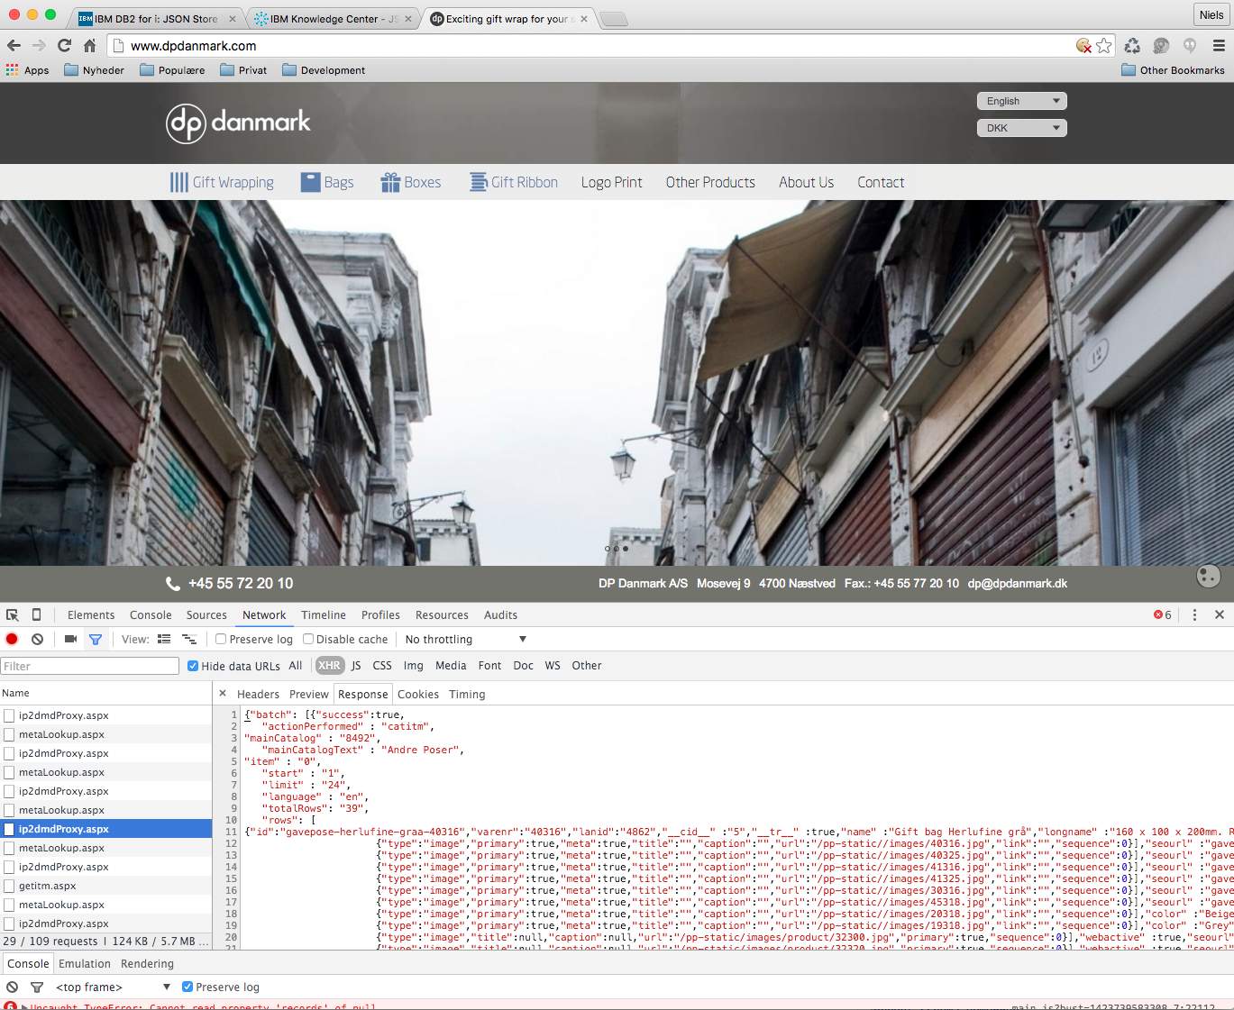
JSON

Slide 11
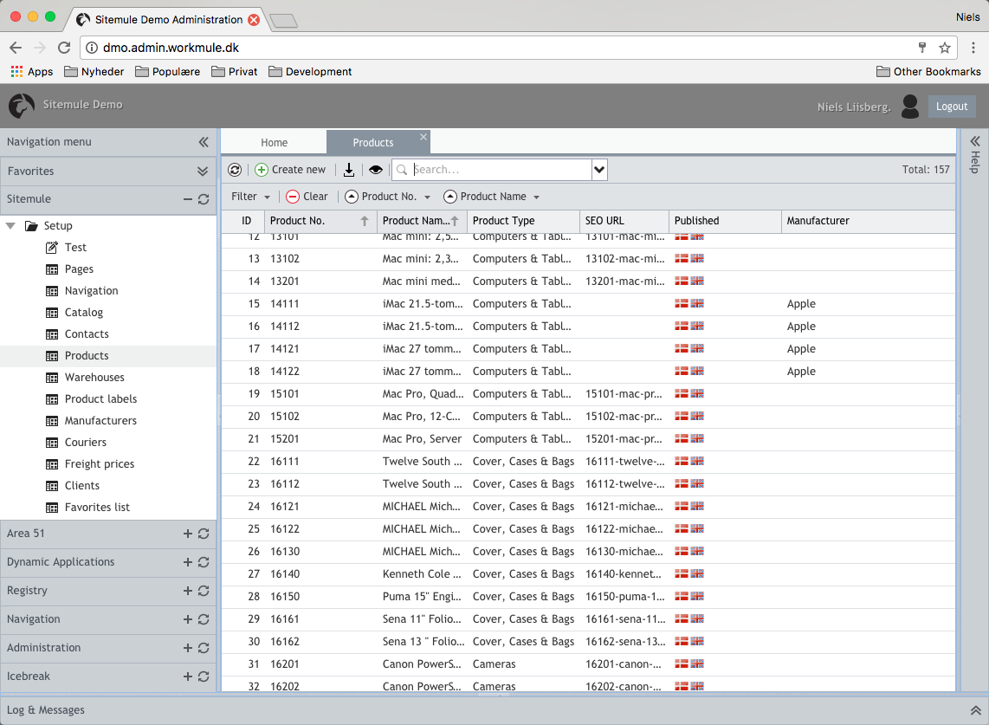
NoSQL scales horizontally vs. vertically
NoSQL:Horizontally
DB2:Vertically

Slide 12
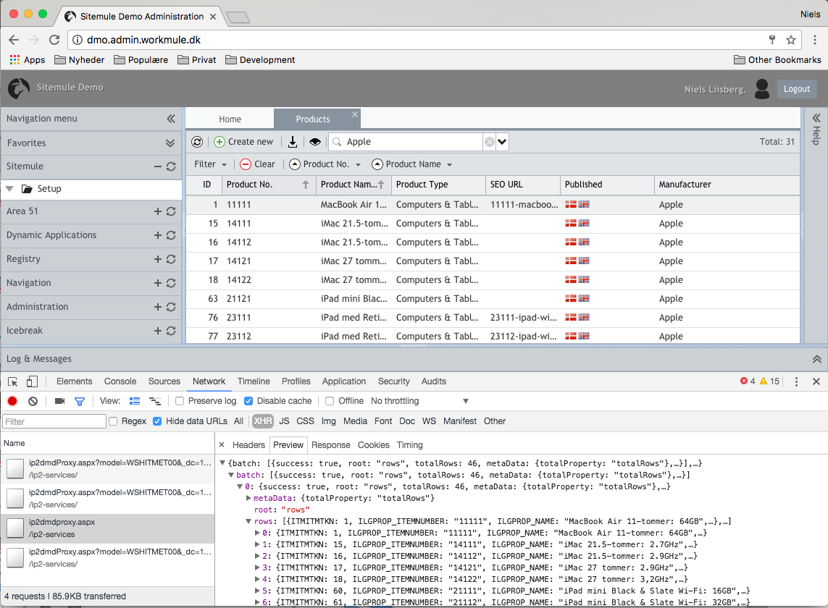
NoSQL scales horizontally vs. vertically
JSON
In
CLOB
NoSQL:Horizontally

Slide 13
Why NoSQL?
  Non-relational !!
  Not Only SQL – it is more
  Unstructured data (abstract data)
  Increasingly used in big-data
  Cool for Web application ( tweets, facebook)
  Strong bindings to JSON (and XML)
  “Eventual consistency” !!

Slide 14
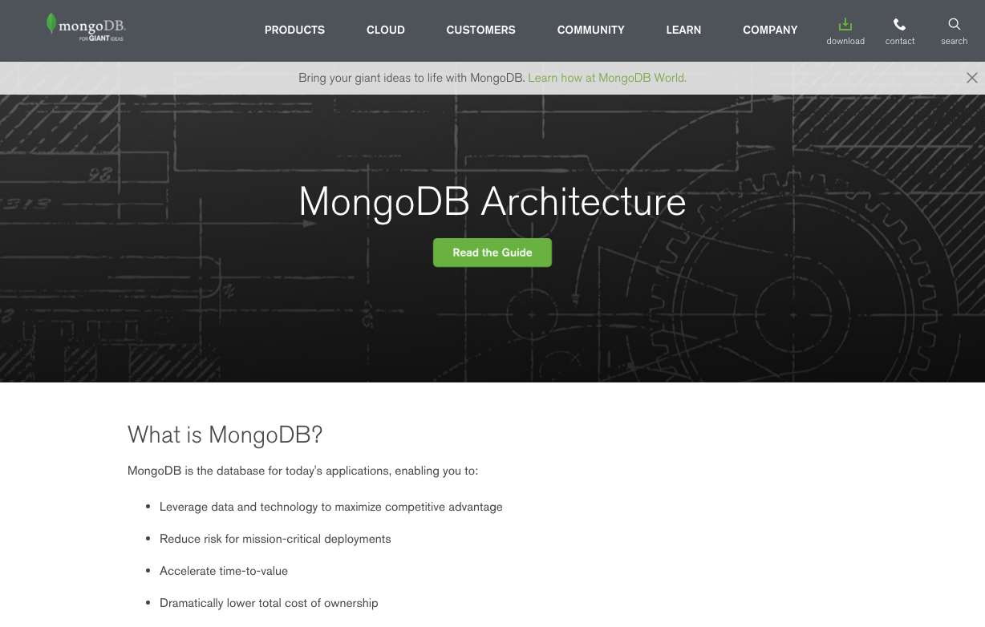

Slide 15
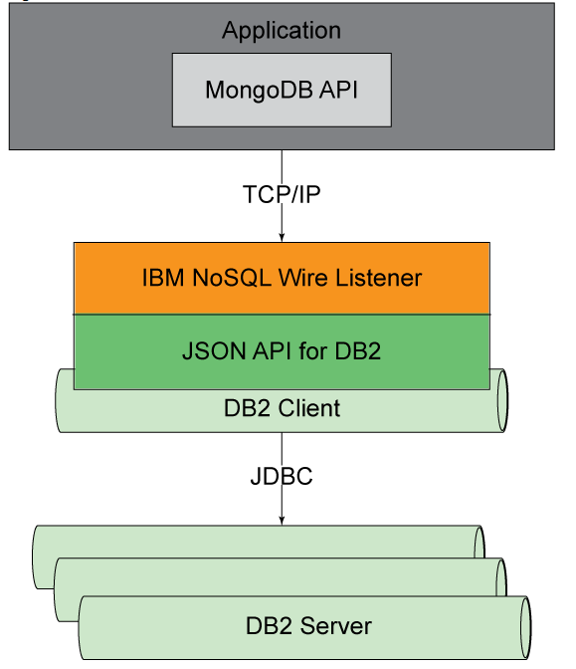

Slide 16
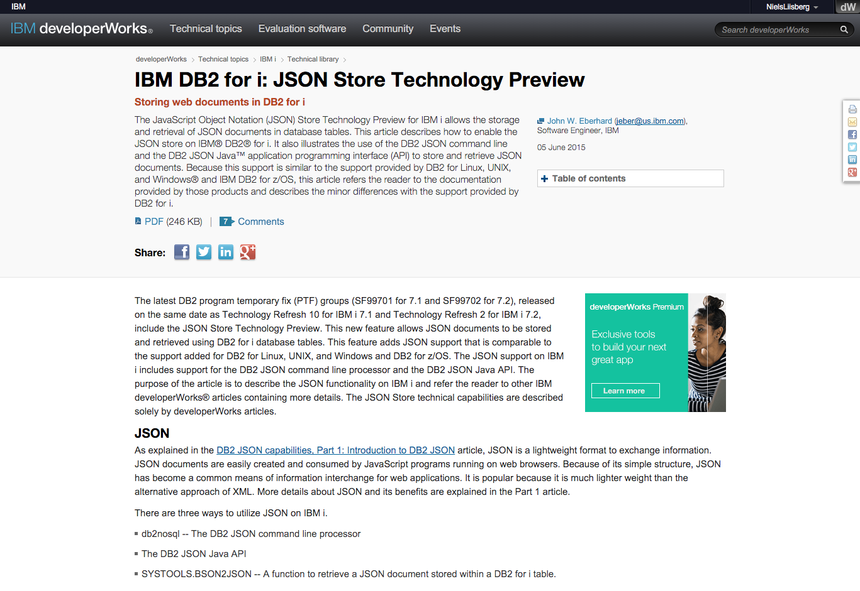

Slide 17
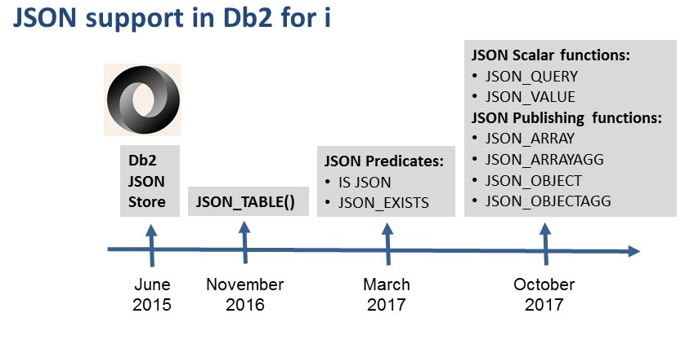
Notes:
First DB2 Family member to have JSON_TABLE support
(note that Oracle has it already)
Why invest in adding JSON into DB2 for i?
JSON is very popular
SQL Standards body is adopting this into the standard

Slide 18
Based on my DB2 SQL workshop:
”DB2 on steroids”
It’s DEMO time ☺

Slide 19
JSON_TABLE
SELECT * FROM
JSON_TABLE(
<JSON-expression> ,
<JSON-path-expression>
COLUMNS (
<column-definitions>
)
<error-option>
)
Converts a JSON expression into relational data
JSON-expressions can be:
  Character or Graphic
  (use FORMAT JSON)
  Binary
  (use FORMAT BSON)
JSON path expression
  lax
    Structural problems are tolerated
    Arrays are automatically unnested
  strict
    Structural problems result in an error
    Arrays are not automatically unnested
Can leverage HTTP Functions
Notes:
FORMAT BSON would equate to using the DB2 JSON Store:
http://www.ibm.com/developerworks/ibmi/library/i-json-store-technology/index.html

Slide 20

JSON Object
JSON objects are represented using a list of key-value pairs
  Curly braces { } indicate object start and end
  Value Pairs are separated by commas
  Keys and values separated by colons
SELECT * FROM
json_table('{"first":"John","last":"Doe"}', '$'
columns("first" VARCHAR(40), "last" VARCHAR(40))) x;

Slide 21





Questions?
  Mail: nli@system-method.com

Slide 22

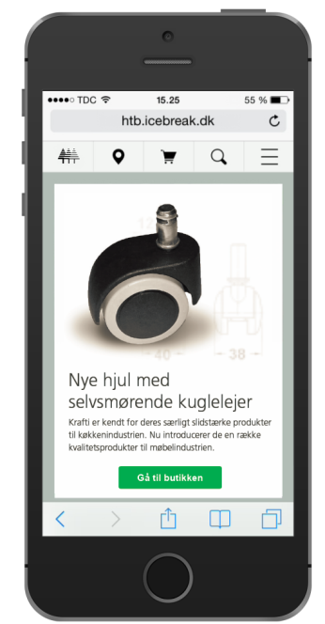
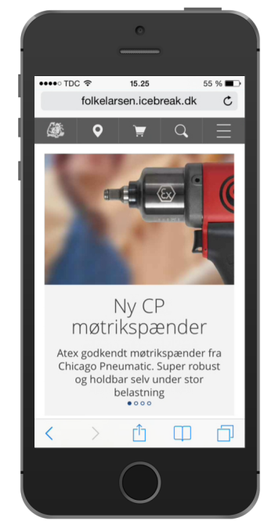

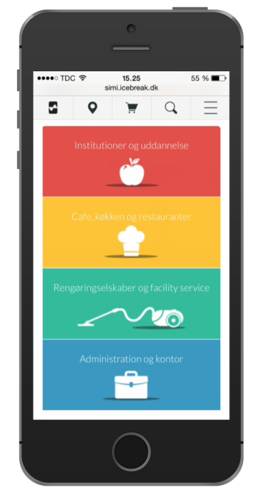
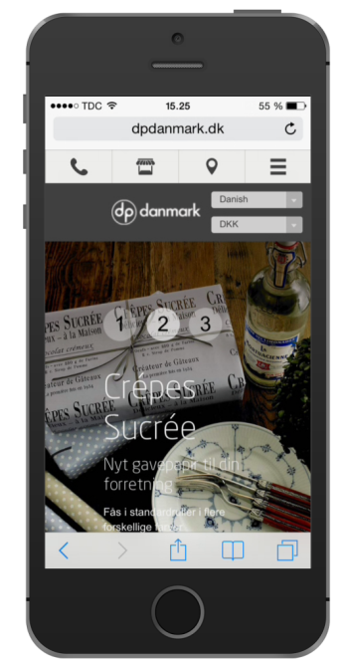
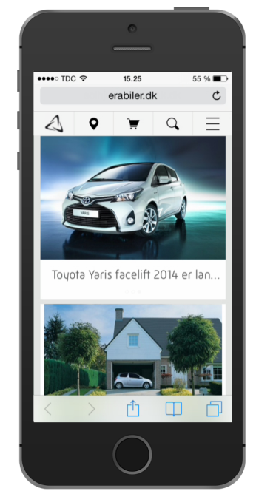







The challenge of today

Slide 23


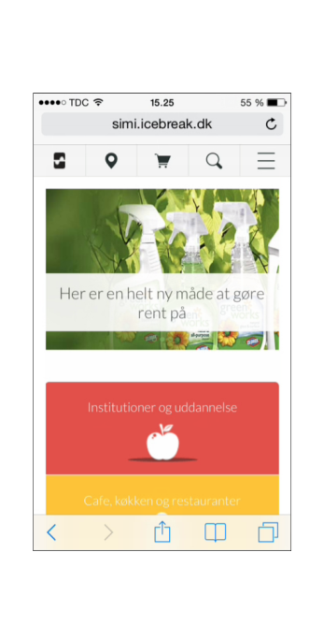

We need a modern look and feel
We need a solid foundation
We need to provide services
We need to consume services
We need to reuse our RPG investment
We need to move on with JAVA, node.js etc
We need to scale up and out
We need JSON
We need to integrate to … a lot
What we need:

Slide 24
We need microservices!

Slide 25
What is microservices?

Slide 26
REST v.s. Microservice
REST / SOAP
Microservices
Service routing & security
Order
Customer
Invoice
Statistics
Customer
Order
Invoice
Statistics

Slide 27
What is a microservice?
JSON
Microservice
JSON
DB2

Slide 28
What is a microservice?
web
web
B2B
B2B
JSON
Microservice
JSON
5250
5250
Micro service
Micro service
Db2 Stored Procedure
Db2 Stored Procedure
DB2

Slide 29
Why this “JSON in - JSON out” paradigm?
Always:
JSON in and JSON out
RPG
Python
Node.js
JAVA
RPG
Python
Node.js
JSON
Microservice
JSON
Microservice
JSON
DB2
DB2

Slide 30


Microservice – how it works
Microservices
Service routing & security
Customer
Invoice
Orders
Statistics

Slide 31
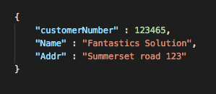
Microservice – how it works
Microservices
Service routing & security
Customer
Invoice
Orders
Statistics

Slide 32
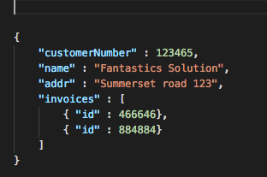
Microservice – how it works
Microservices
Service routing & security
Customer
Invoice
Orders
Statistics

Slide 33
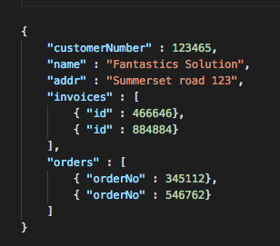
Microservice – how it works
Microservices
Service routing & security
Customer
Invoice
Orders
Statistics

Slide 34
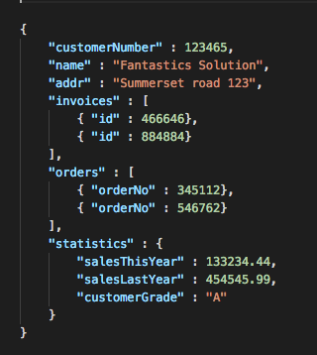
Microservice – how it works
Microservices
Service routing & security
Customer
Invoice
Orders
Statistics

Slide 35
Microservice – how it works
Microservices
Service routing & security
Customer
Invoice
Orders
Statistics

Slide 36
Microservice – how it works
Microservices
Service routing & security
Customer
Invoice
Orders
Statistics

Slide 37
Microservice – how it works
Microservices
Service routing & security
Customer
Invoice
Orders
Statistics

Slide 38
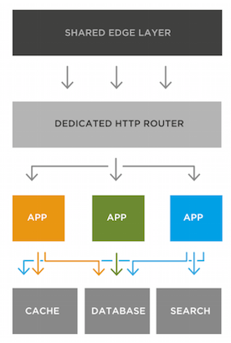
Why microservices?
Run in any environment (On premises, Cloud..)
JSON in, JSON out.
Easy unit testing
Graceful error handling.
Can be written in any language
Better lifecycle. Easy to replace
Can be reused, called from an other application
Don’t rely on HTTP – why not a dataqueue?
Easy to debug and unit test
Easy to extend
Require some kind of routing / security layer
This is what all the young ladies craves

Slide 39
The Stone Age didn’t end because we ran out of stones
How can we reuse our RPG investments?
How can we embrace new technology:
  Node.js, python, ruby, JAVA, puff++, gnuffy, blabla#?
How can we scale up and scale out
  Docker, cloud, bluemix?

Slide 40





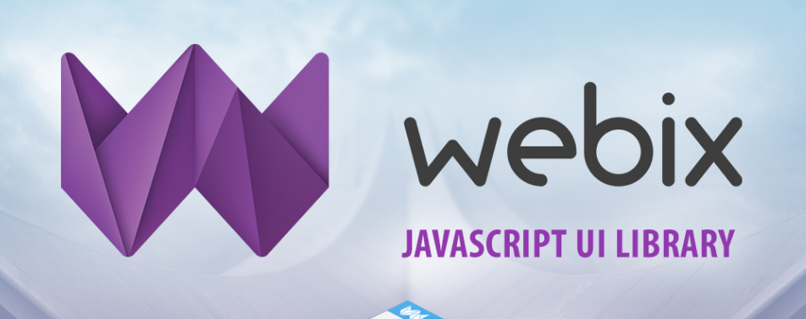


Why?
To invite all kind of web technology on board the IBMi:

Slide 41
Questions?
By:
Niels Liisberg
nli@system-method.com
System & Method A/S

