Slide 1

Microservices on IBMi
By:
Niels Liisberg
Chief architect
System & Method A/S
i-UG final meeting - 2017

Slide 2
Microservices on IBMi
Why microservices?
What is microservices?
You will learn to say: “JSON in – JSON out”
Live stuff !! ( Hopefully – otherwise a short presentation aka. a long coffee break )
  See node.js on IBMi
  See git on IBMi
  See ssh and bash
  See seneca framework on IBMi
  RPG microservice and ExtJS
  RPG microservice talk to Watson

Slide 3

Who is Niels Liisberg?
IBM Power evangelist
“The doctor” – transformation consultant
System & Method A/S – Denmark
Father to IceBreak^{tm} – Application server for RPG
Architect of Sitemule^{tm} – Web platform for IBMi
CEAC – Common Europe Advisory Council member
Devoted Open source fanatic:
  https://github.com/NielsLiisberg
Founder of IBM Power CPH
Follow me at tweeter, github, linkedin , gluf, clap or what ever…

Slide 4
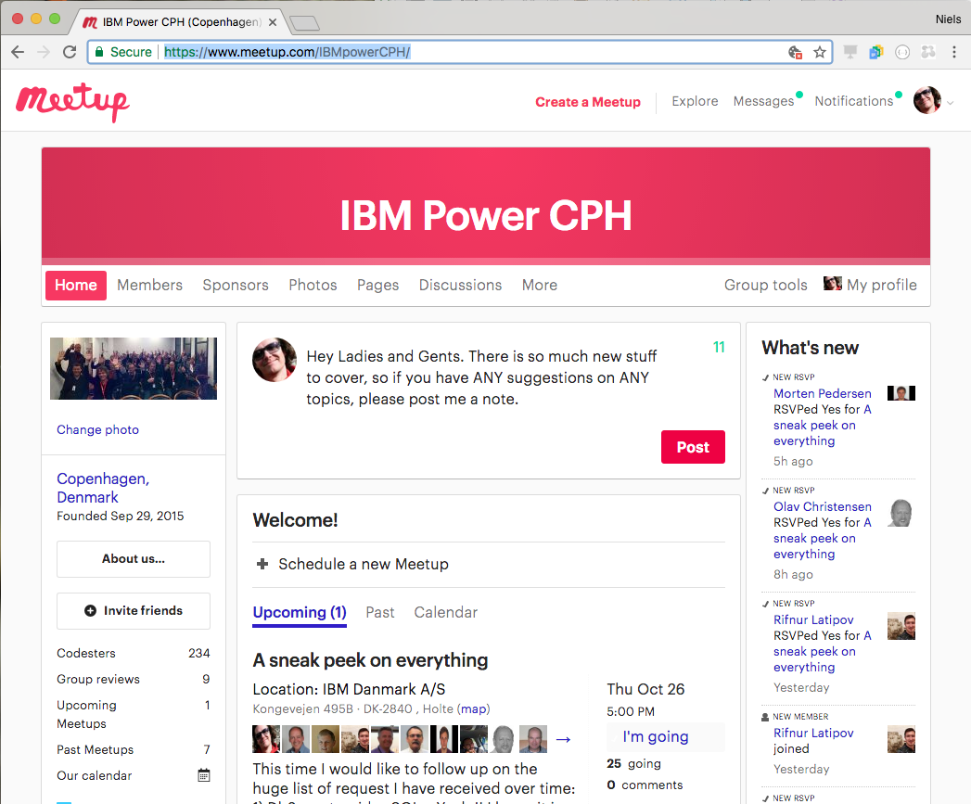

Slide 5
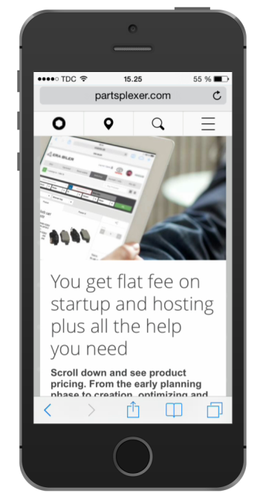
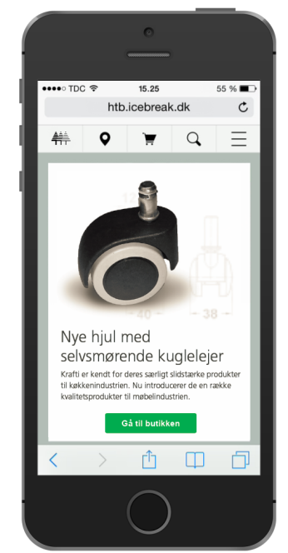
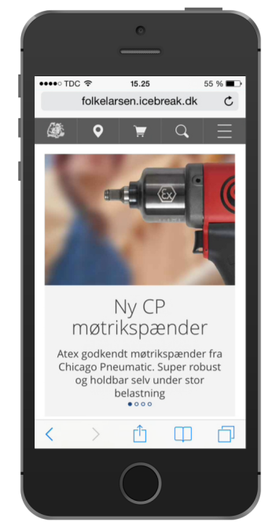
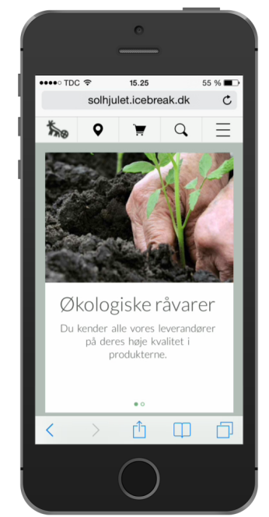
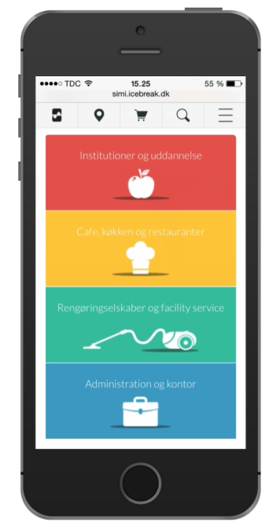
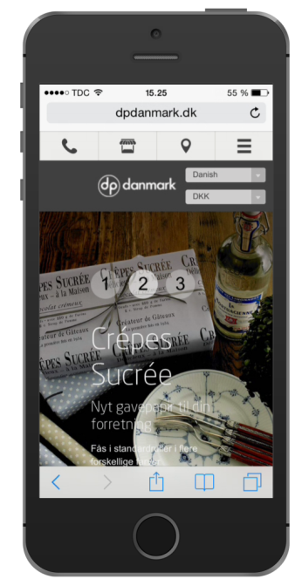
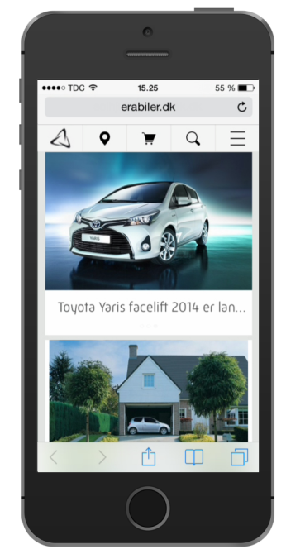







Today’s challenge

Slide 6


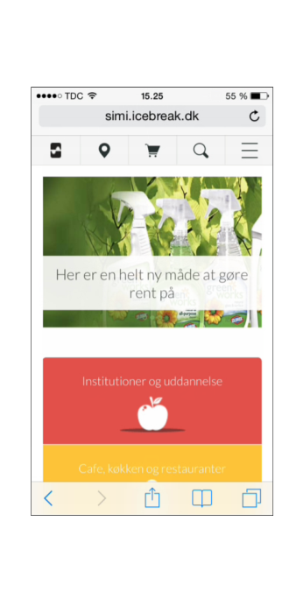

We need a modern look and feel
We need a solid foundation
We need to provide services
We need to consume services
We need to reuse our RPG investment
We need to move on with JAVA, node.js etc
We need to scale up and out
We need JSON
We need to integrate to … a lot
What we need:

Slide 7
We need microservices!

Slide 8
What is microservices?

Slide 9
REST v.s. Microservice
REST / SOAP
Microservices
Service routing & security
Order
Customer
Invoice
Statistics
Customer
Order
Invoice
Statistics

Slide 10
What is a microservice?
JSON
Microservice
JSON
DB2

Slide 11
Why this “JSON in - JSON out” paradigm?
Always:
JSON in and JSON out
RPG
Python
Node.js
JAVA
RPG
Python
Node.js
JSON
Microservice
JSON
Microservice
JSON
DB2
DB2

Slide 12
What is a microservice?
web
web
B2B
B2B
JSON
Microservice
JSON
5250
5250
Micro service
Micro service
Db2 Stored Procedure
Db2 Stored Procedure
DB2

Slide 13


Microservice – how it works
Microservices
Service routing & security
Customer
Invoice
Orders
Statistics

Slide 14
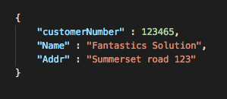
Microservice – how it works
Microservices
Service routing & security
Customer
Invoice
Orders
Statistics

Slide 15
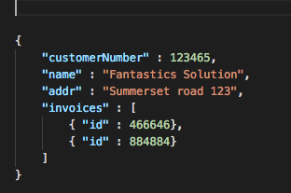
Microservice – how it works
Microservices
Service routing & security
Customer
Invoice
Orders
Statistics

Slide 16
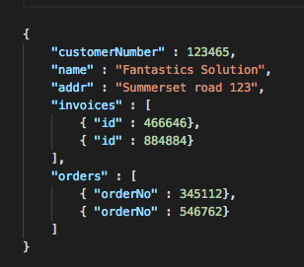
Microservice – how it works
Microservices
Service routing & security
Customer
Invoice
Orders
Statistics

Slide 17
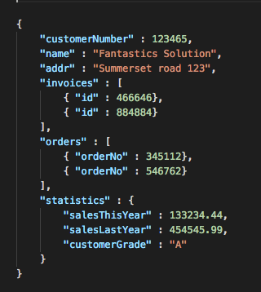
Microservice – how it works
Microservices
Service routing & security
Customer
Invoice
Orders
Statistics

Slide 18
Microservice – how it works
Microservices
Service routing & security
Customer
Invoice
Orders
Statistics

Slide 19
Microservice – how it works
Microservices
Service routing & security
Customer
Invoice
Orders
Statistics

Slide 20
Microservice – how it works
Microservices
Service routing & security
Customer
Invoice
Orders
Statistics

Slide 21
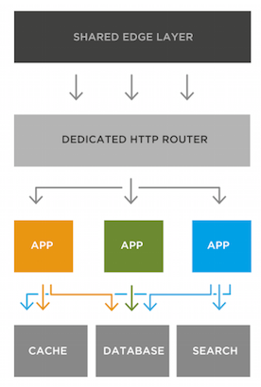
Why microservices?
Run in any environment (On premises, Cloud..)
JSON in, JSON out.
Easy unit testing
Graceful error handling.
Can be written in any language
Better lifecycle. Easy to replace
Can be reused, called from an other application
Don’t rely on HTTP – why not a dataqueue?
Easy to debug and unit test
Easy to extend
Require some kind of routing / security layer
This is what all the young ladies craves

Slide 22
The Stone Age didn’t end because we ran out of stones
How can we reuse our RPG investments?
How can we embrace new technology:
  Node.js, python, ruby, JAVA, puff++, gnuffy, blabla#?
How can we scale up and scale out
  Docker, cloud, bluemix?
Convert to the metric system inch by inch:
Use microservices

Slide 23


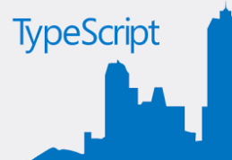


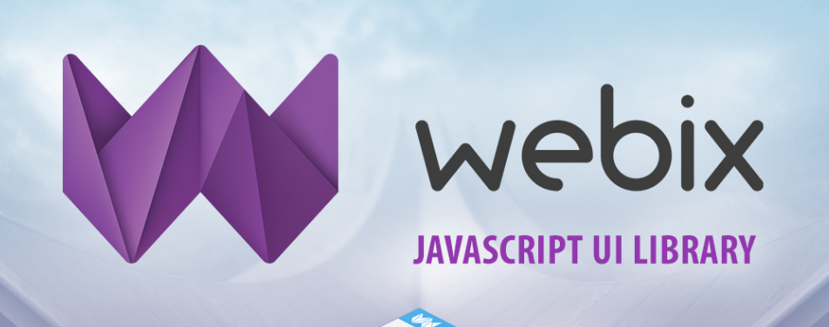


Why?
To invite all kind of web technology on board the IBMi:

Slide 24




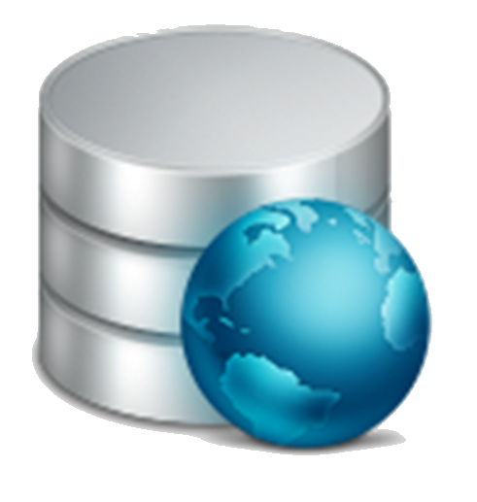
Microservice architecture
Browser
Tablet Smartphone
Partner
B2B
Applications:
C#/java
Data Provider
(Service)
REST
SOAP
Sitemule™ micro services
Fast CGI
IceBreak
IceCap
Ninja
DB
Node.js
Spring-boot/JPA
RPG
5250
Java Script
Java Script
Java
Python
Ruby
Rails
PHP
CGI

Slide 25
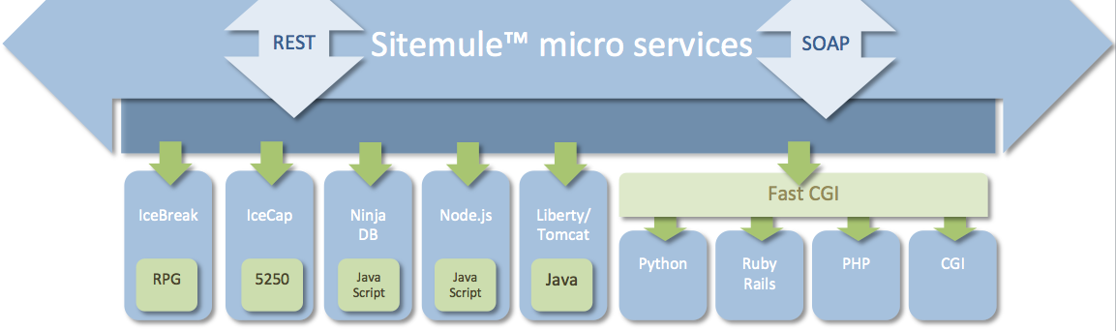

Microservice architecture
Sales
Products
Manufacturer
Purchase
Forecast
Invoice
order
Items
Prices
History
Customer
Relations
JSON in / JSON out
DB2

Slide 26
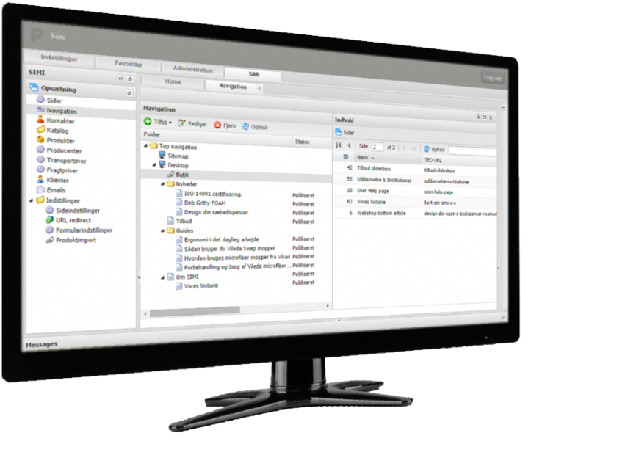
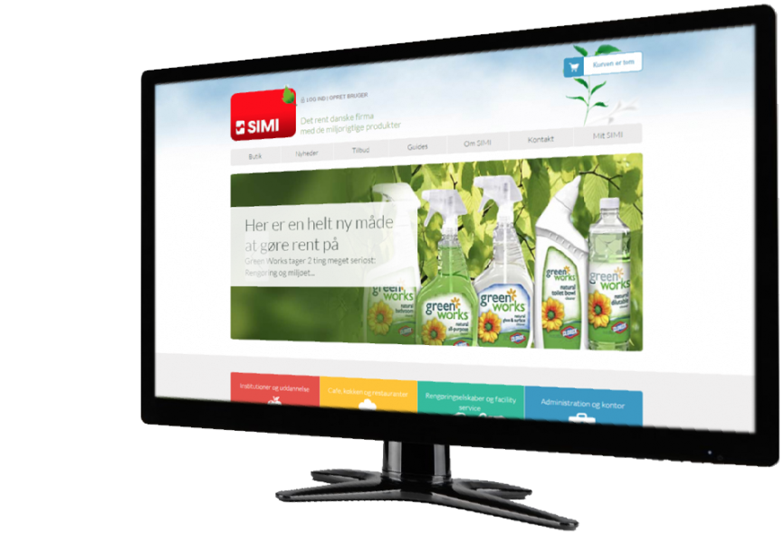
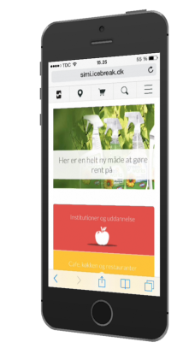
How can it be used?
Administration
Homepages
Orchestrate RPG, JAVA, node.js, python:
Modernize existing 5250
Common look-n-feel
Menu- and Administrations system
User, user groups, roles and language control
Web shop with/out login and/or payment
Homepage
CMS, SEO optimized function
Text, Article and presentations pages
Media galleries, Teaser, Quotes, Forms
Product catalogues with/out prices
Product families, relations and alternatives
Favourites and ”Previously bought products”

Slide 27
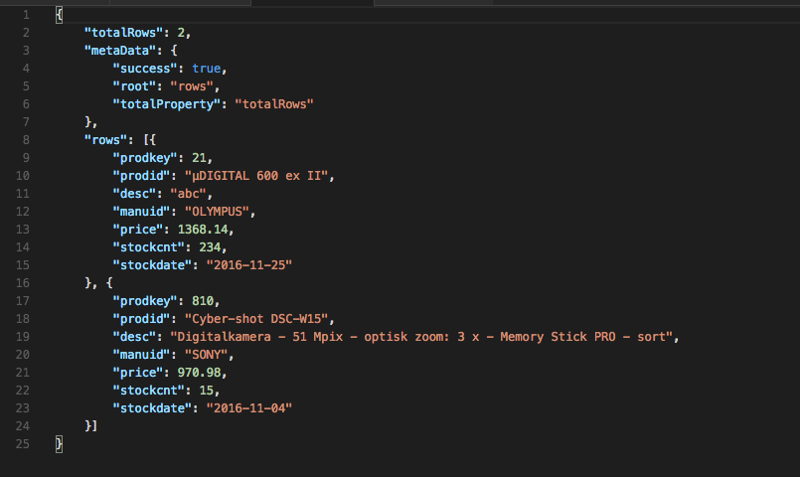
What is JSON?
Lightweight transporter protocol
Any abstract data types
Any complex data
Human readable
Easy to parse in any environment (IoT)
Easy to produce
Cross age/culture developer Esperanto
Only by simple components:
  Primitives, arrays and object

Slide 28
Why JSON?
A humongous number of JSON transactions
New design paradigms – MVC / MVVM
Simple to produce in RESTfull services

Slide 29
Model View Control?
MVC / MVVM
Model
View
Controller
Web Server
IBMi
Client

Slide 30
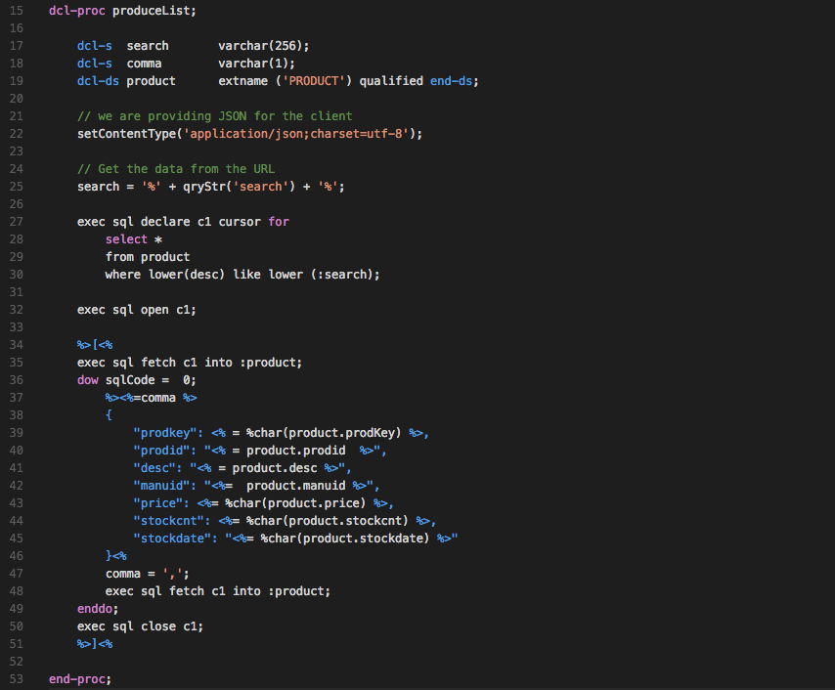
JSON is easy to produce

Slide 31
But - what is wrong in this picture?
Access the HTTP protocol header
Access the URL directly
Static binding to SQL table layout
Construct the JSON by hand and send it by HTTP

Slide 32
What is wrong in this picture
PLUMBING!!
Error prone to the output quality ( well formed JSON)
Require knowledge of the HTTP protocol
Is only accessible from the HTTP protocol
Can not be reused, ( called from an other application)
Can not be unit tested
Hard to extend
Hard to debug

Slide 33
Any language?
Of cause!! You can make microservices with almost all languages:
JAVA – spring boot framework
Python
node.js – seneca
RPG with noxDB
Ruby

Slide 34
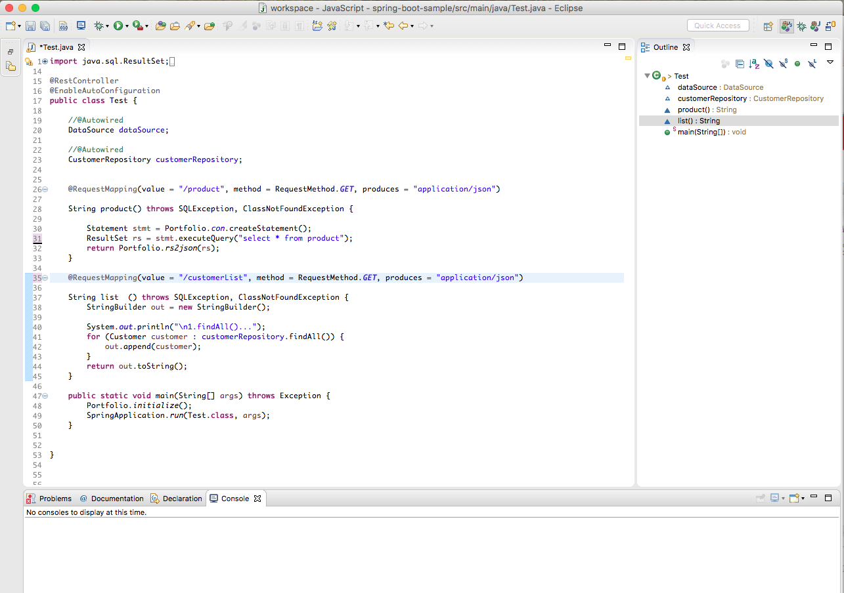
Java Spring Boot

Slide 35
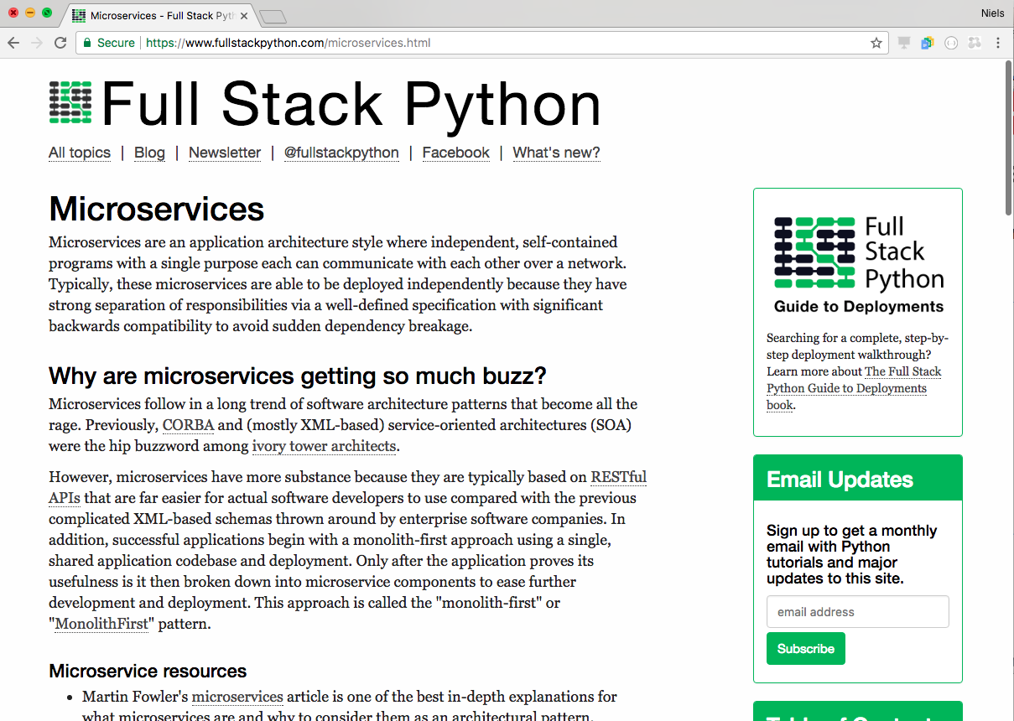

Slide 36
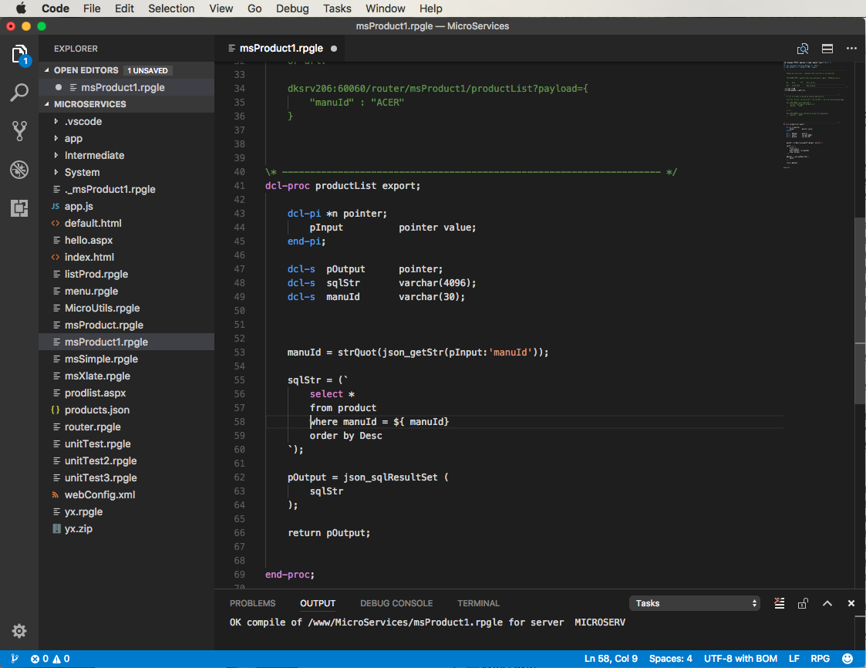

Slide 37
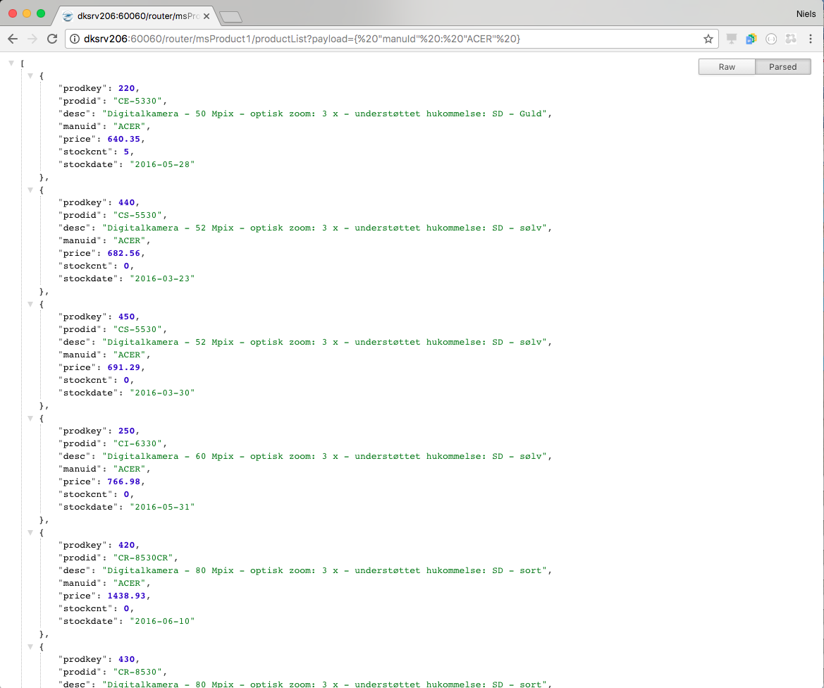

Slide 38
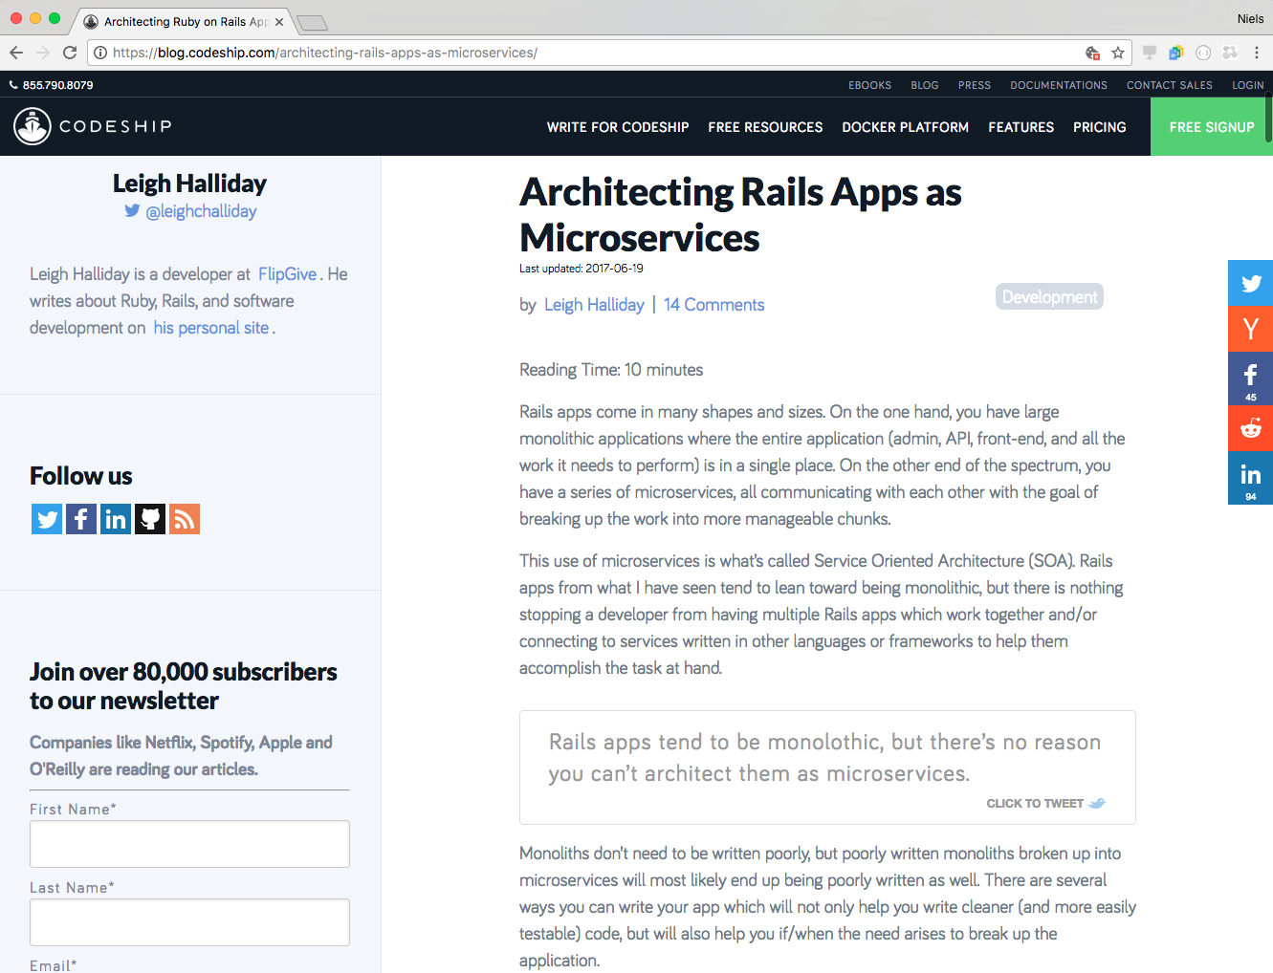

Slide 39
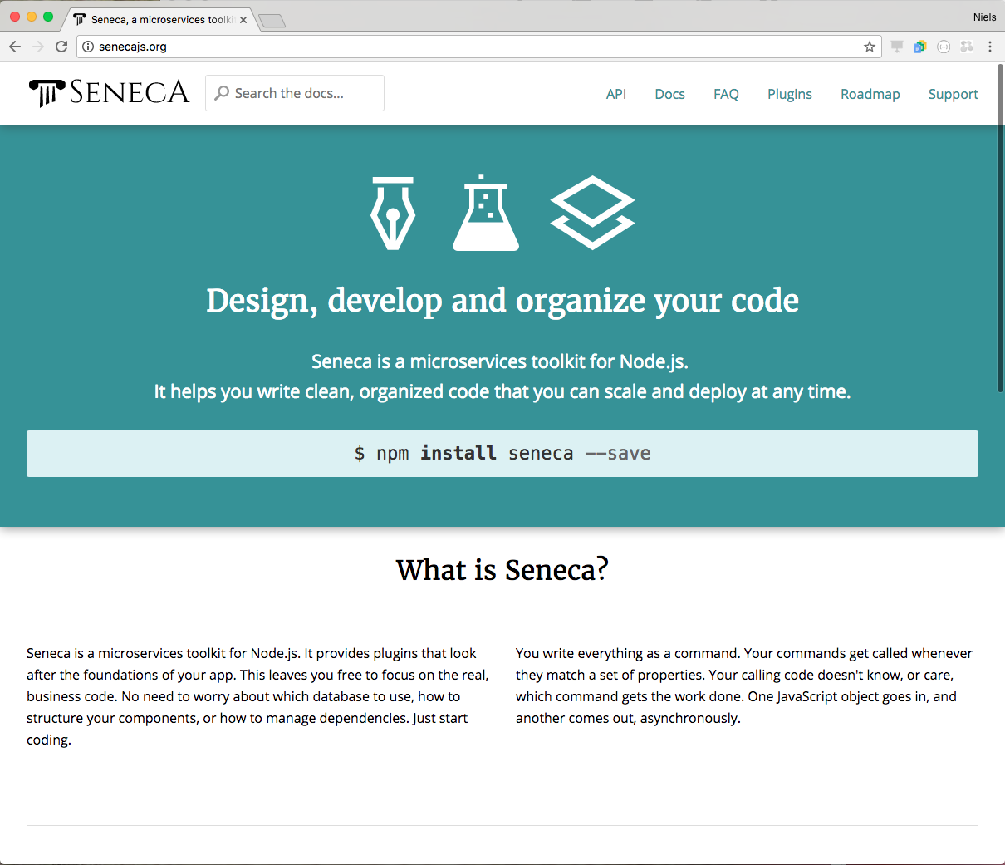

Slide 40
Microservices on IBMi with node.js
Seneca
Is a micro service framework for node.js – Can we make it run on power – let’s try:
ssh or call qp2term on your IBMi ( mine is dksrv133)
Mkdir /seneca
git -c http.sslVerify=false clone https://github.com/senecajs-attic/getting-started.git
cd getting-started
Npm install
echo "require('seneca')().use('math').listen()" > msTest.js
node msTest.js
Now try this in your browser:
http://dksrv133:10101/act?role=math&cmd=sum&left=1&right=2

Slide 41
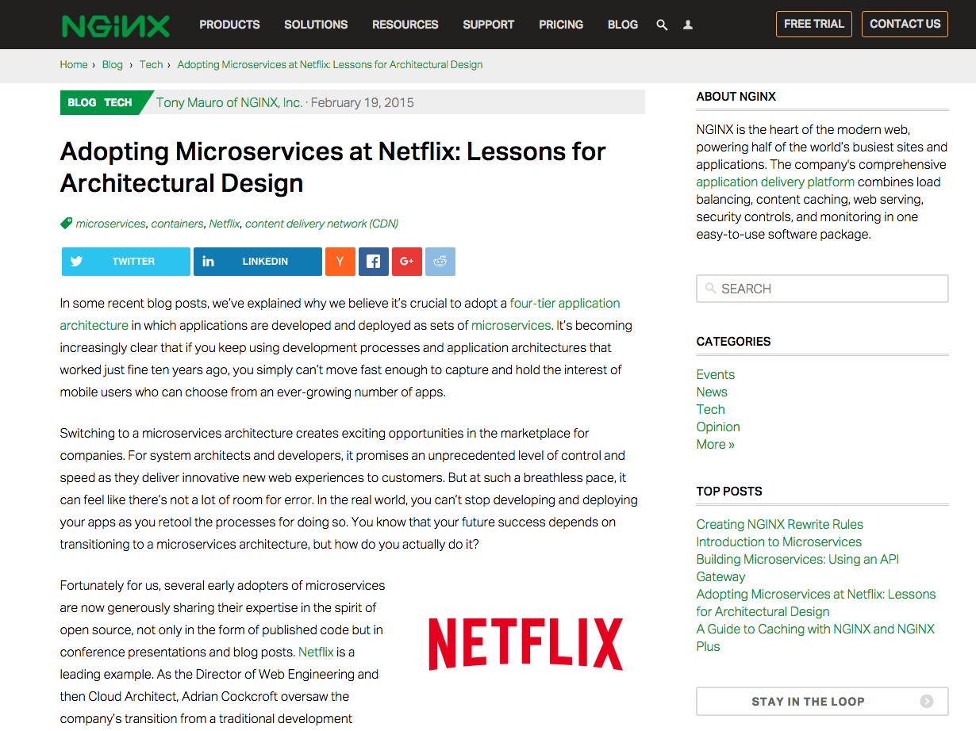

Slide 42
Microservices on IBMi
Questions?
By:
Niels Liisberg
System & Method A/S

Slide 43
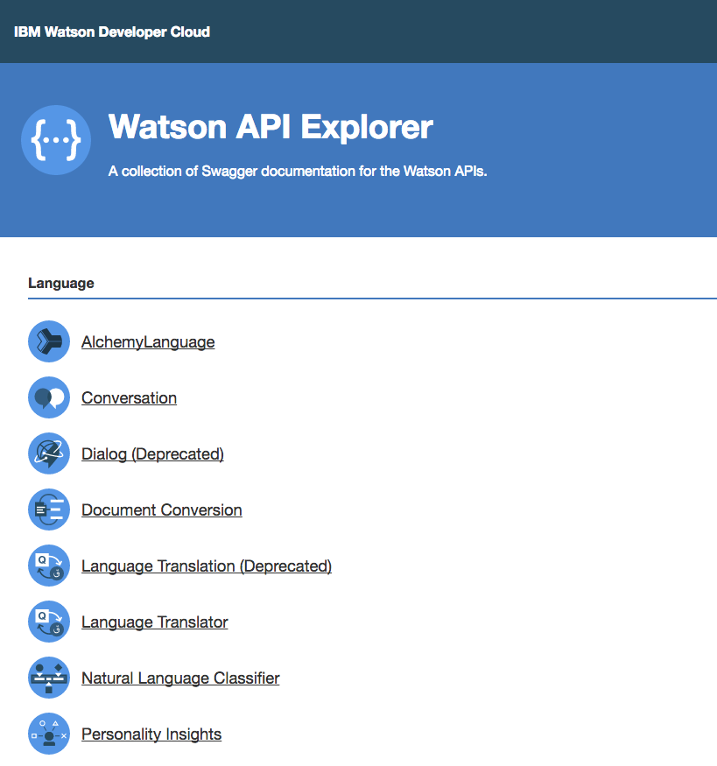
Let’s talk with Watson
Watson has an REST api we can utilize. Let’s play

